Slide 1

MGM Institute of Physiotherapy
Aurangabad
MAHATMA GANDHI MISSION
Didactic Lecture

Slide 2



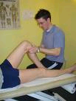
Introduction to Musculoskeletal/
Orthopedic Assessment
Dr. surendra Wani
Dept. Of Musculoskeletal Physiotherapy
MGM Institute Of Physiotherapy
Chh. Sambhajinagar

Slide 3
Learning Objectives
At the end of the lecture, the student should be able to:
  Determine the principles and concepts of a musculoskeletal assessment
  Identify cues and information that needs to be obtained in a subjective musculoskeletal assessment
  Formulate hypothesis of the problems assessed and determine examination procedures that may confirm or refute a hypothesis

Slide 4

Components of a Comprehensive Musculoskeletal/Orthopedic Assessment
Subjective Assessment/
History Taking
Objective Assessment/
Physical Examination
Demographic Data

Slide 5

Demographic Data
Name
Age
Occupation – identify work requirements
  Repetitive movements
  Position of limb at work
Recreational pursuits/ sports
Activities of daily living
Gender
Marital status
Address
Nationality
Handedness
Notes:
A means of acquiring general information from the patient
Age: Many conditions occur with certain age ranges
Sex/gender: demographic characteristic associated with certain diseases
Recreational pursuits / sport
Activities of daily living
Address: faciltates conduct of epidemiologic researches
Religion: Allows the interviewer of the kind of approach to make when conducting the examination

Slide 6
Demographic Data
Date admitted ( for in-patients )
Admitting unit ( for in-patients )
Attending physician
Date evaluated
Date of initial evaluation
Working diagnosis

Slide 7

Subjective Assessment
Chief complaint
Current history/ mechanism of injury
Area and type of symptoms
24-hour pain behavior
Aggravating and alleviating factors
Past history of the condition (if any)
Past medical history
Family medical history
Personal/Social history
Ancillary procedures
Medications
Previous treatment and effect (if any)

Slide 8

CHIEF COMPLAINT and
PATIENT’S GOALS
Usually stated as the problem that bothers them the most
Can be written verbatim: patient’s own words
Patient’s goal/s
  Is it realistic? Is it achievable?
  Allows the patient to have an active role in the planning of the treatment program

Slide 9
CURRENT HISTORY
History of the present illness
Provides information about the onset of the disorder
  When the injury happened
  Mechanism of injury (how the injury occurred)
  Symptoms after the injury
  Progress of symptoms
  Treatment provided (if any) and effects of the treatment

Slide 10
Current History:
Onset of Symptoms
Provides information of the relative stage of injury
  Acute: 0 to 7 days after injury
  Sub-acute: 7 days to 7 weeks after injury
  Chronic: more than 7 weeks after injury
Allows the therapist to:
  identify appropriate intervention
  prognosticate
An insidious onset not related to injury or unusual activity is suspicious
  Neoplasm
  Degenerative lesions
  Lesions due to tissue fatigue

Slide 11

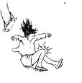


Current History:
Mechanism of Injury
Used to formulate diagnosis
Direction, position, and nature of the injuring force may provide clues which tissues could have been injured
  Correlation can be made to the signs and symptoms for interpretation
  The magnitude of the injuring force and the severity of injury can be compared
Take note of unusual injury patterns as these could be a sign of an abnormal tissue status prior to injury

Slide 12
Current History:
Progress of Symptoms
Inquire if the patient’s symptoms get better, worse, or essentially status quo and in what way/manner
  Most musculoskeletal injuries get better over time primarily due to the normal healing process (~ 6 weeks)
  Some disorders may actually get worse over time → underlying pathology
    Pain that radiates: extends to include other areas
    Presence of paresthesia following initial pain
Prognosis is good is the patient’s symptoms are improving

Slide 13
PAIN

Slide 14

DEFINITION:
“Pain is defined as an unpleasant sensation & emotional experience associated with or without actual tissue damage.”

Slide 15
  SOCRATES:
  Site
  Onset
  Character
  Radiation
  Aggravating factors
  Timings
  Exacerbating factors
  Severity

Slide 16

Area and Type of Symptoms:
Area
Provides information regarding:
  Source of the problem
  Prognosis
Used as baseline measure when monitoring treatment effects

Slide 17

AREA AND TYPE OF SYMPTOMS
May employ a body chart
  Identify areas and types of symptoms
  Initial determination of the relationship between the symptomatic areas

Slide 18
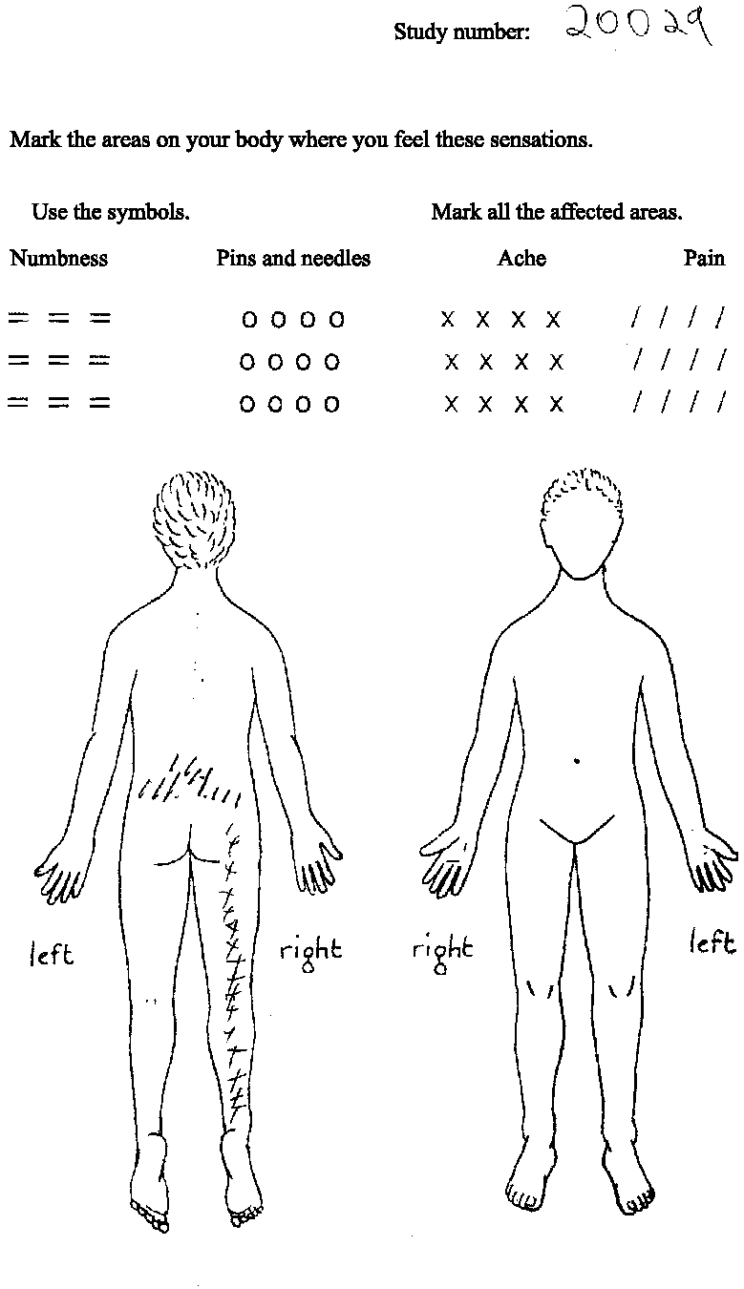
LOCALIZING PAIN SYMPTOMS:
PAIN DRAWINGS:

Slide 19
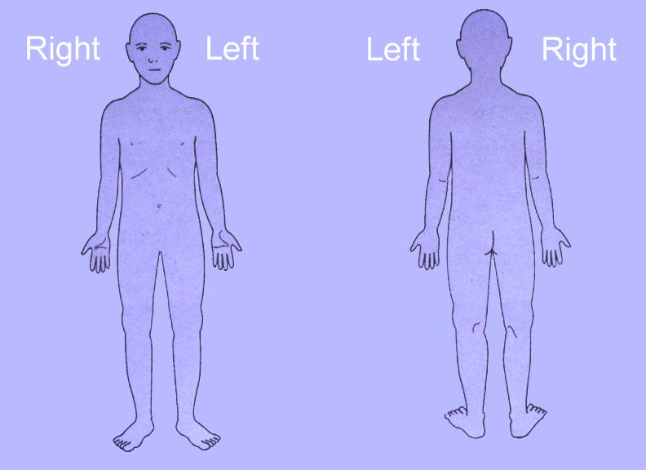
Use diagram to have child locate pain

Slide 20
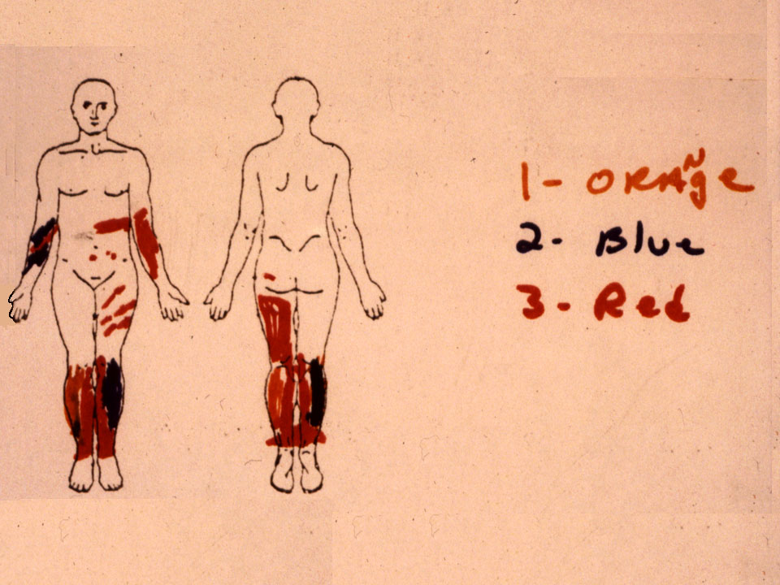
Burn patient’s drawing

Slide 21
Onset
Gradual
Sudden
insidious

Slide 22
Type of Symptoms: character/Quality
Refers to the description of pain
  Interprets pain based on the pathology or structures involved
Indicates the severity of the pain experience
  As part of a disability questionnaire

Slide 23
Type of pain | Possible structure
Cramping, dull, aching | Muscle
Sharp shooting | Nerve root
Sharp, bright, lightning type | Nerve
Burning, pressure like, stinging, aching | Sympathetic nerve
Deep nagging dull | Bone
Sharp severe intolerable | Fracture
Throbbing diffuse | Vasculature

Slide 24
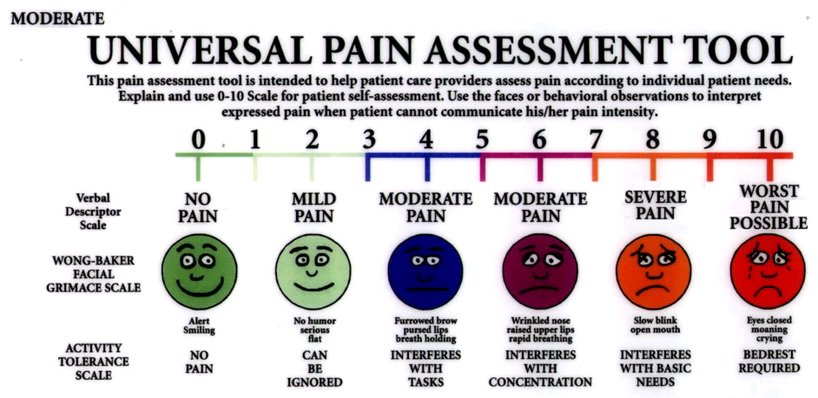
Area and Type of Symptoms:
Intensity
Rating severity of the symptoms based on a scale
  Usually range from 0 (no pain) to 5/10 (severe pain)
  Visual Analogue Scale: a 10-cm line with pain descriptors at each end (“no pain” to “pain as bad as it could be”)
May assist in determining prognosis
May be a reliable indicator of progress as the patient is providing information regarding the pain experience

Slide 25

PAIN MEASUREMENT:
Measuring pain intensity:
a.) visual analog scale-
The client rates the pain on a continuum that begins with ‘no pain’ & ends with ‘max pain tolerable’.

Slide 26
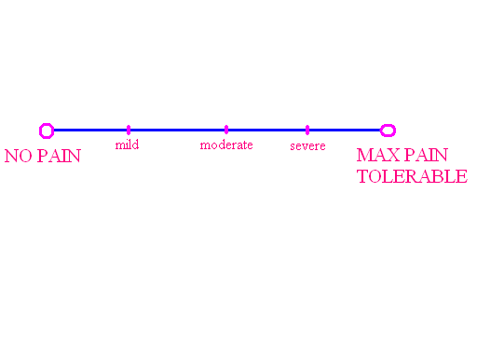
b.) Simple descriptive pain scale:
The client rates the pain on scale that is subdivided into, no pain , mild, moderate & severe pain.

Slide 27

c.) Pain estimate:

Slide 28
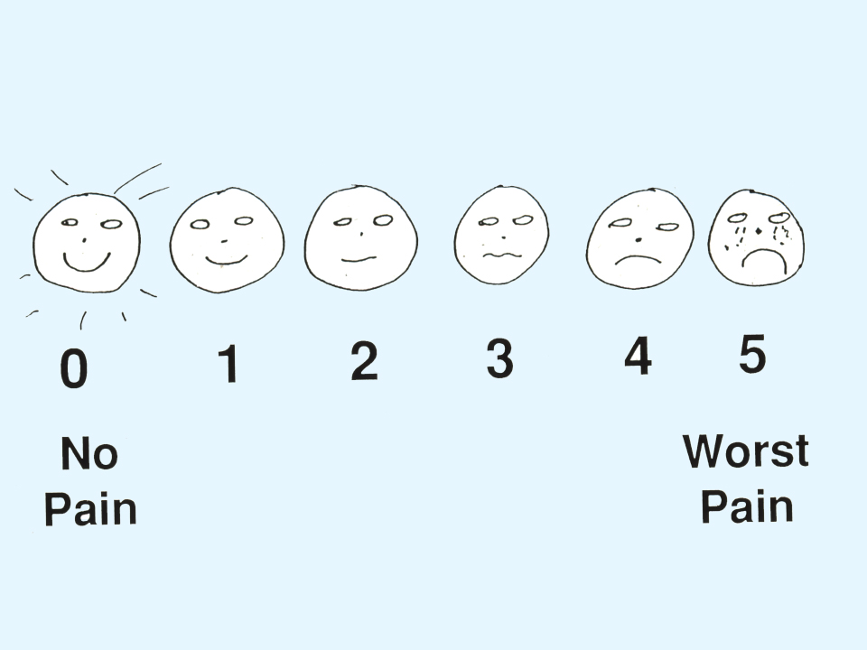

d.) Faces pain scale:

Slide 29
e.) Pain diary
Diaries are another way to gain prospective, subjective view of a patients pain if the pain is persistent or chronic.
It is helpful way to measure the impact of the pain on the patients life.

Slide 30
TIME | PAIN | ACTIVITY | MOOD | SITE | MEDICATION
6:00 AM
7:00AM
8:00AM

Slide 31

Photographic/
Numeric Pain Scale
Oucher scale (Beyer)
White child, 3 year-old male

Slide 32

Photographic/
Numeric Pain Scale,
Oucher scale (Beyer)
Black child, school age, male

Slide 33
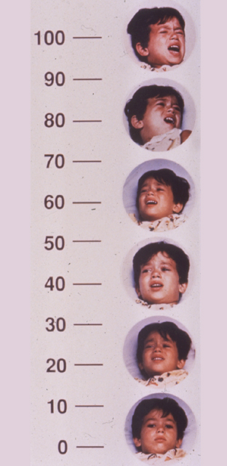
Photographic/
Numeric Pain Scale,
Oucher scale (Beyer)
Hispanic child, school age, male

Slide 34
Area and Type of Symptoms:
Depth
It was previously believed that the depth of pain is related to the depth of injury.
Invalid considering spinal nerve or nerve root involvement
  Imperative to have a good background knowledge of distribution/referral patterns for anatomical structures

Slide 35


Area and Type of Symptoms:
Relationship of Symptoms
Evaluate if the symptoms arise from one source or multiple sources
  Identify whether symptoms are provoked independently (unrelated) or worsen all together (related)

Slide 36


24-HOUR BEHAVIOR
Status of symptoms
  At night
  In the morning
  Throughout the day: do the symptoms vary?
Knowledge of the behavior of the symptoms provides information in:
  Formulation of diagnosis
  Identifying plan of care
  Monitoring of the progress of condition
  Prognosis but only to a lesser extent

Slide 37
24-Hour Behavior:
Night Pain
Does the patient have any difficulty sleeping because of the symptoms?
Does the pain wake the patient during sleep?
  Probe deeper as to the quality of pain that cause such disturbance in sleep pattern
Determine worst and best sleeping positions
  Incorporated in the patient care plan as interventions should increase patient’s
  comfort and ability to sleep

Slide 38
24-Hour Behavior:
Morning Pain
Provides information on how condition responds to rest
Identify the course of the symptom throughout the day

Slide 39
AGGRAVATING/ALLEVIATING FACTORS
What activities/positions aggravate/relieve the symptoms?
Knowledge of these may help in the diagnosis (identifies presence or absence of a mechanical problem), plan for physical examination, and the formulation of management

Slide 40

Area and Type of Symptoms:
Anesthesia/Paresthesia
Paresthesia vs. anesthesia
  Paresthesia: altered sensation in an area
  Anesthesia: absence of sensation (numbness)
Presence of altered sensation is suggestive of nerve compromise, particularly if the symptom distribution is dermatomal
(Helfelt and Greubel 1978)
Most common cause of altered sensation accompanying spinal disorders is spinal/ nerve root compromise (Bogduk 1991)

Slide 41
Area and Type of Symptoms:
Constancy
Are the symptoms present continuously?
Does the intensity of symptoms vary with movement or positioning?
  Pain or paresthesia that is better or worse with movement or positioning is likely to be musculoskeletal in origin
Provides information regarding prognosis
Pain on activity that decreases with rest
Pain or aching as the day progress
Resting pain/ pain that is worse at the beginning of the activity
Intractable pain
Intermittent claudication
IV disc pain vs. facet pain
Notes:
Magee
Pain on activity decreases with rest- mechanical problem ( adhesions, tightness )
Morning pain with stiffness as the day progress - chronic inflammation, edema
Pain or aching as the day progress - increased congestion in the joint
Resting pain/ pain worse at the beginning of the activity - inflammation
IV disc vs facet - tested in standing, sitting, bending

Slide 42
Pain on activity decreases with rest- mechanical problem ( adhesions, tightness )
Morning pain with stiffness as the day progress - chronic inflammation, edema
Pain or aching as the day progress - increased congestion in the joint
Resting pain/ pain worse at the beginning of the activity - inflammation
IV disc vs facet - tested in standing, sitting, bending

Slide 43
IRRITABILITY
The ease with which a condition is exacerbated by movement
Three key questions to ask in order to determine the irritability of a condition:
  What activity (and how much) aggravates symptoms?
  How severe is the pain?
  After cessation of the activity, how long till the pain returns to resting level?
What irritability of a condition provide the therapist?
  How many and what active movements to examine
  How far through the range of movement should the examination be performed
  Which examination procedures to perform

Slide 44

Current History:
Treatment received and effects
If the patient has already been treated for the same injury in the past, or has received treatment prior to physical therapy consult, it is important to inquire about the type of intervention provided and the effects
  Are noted changes for the better/worse?
Provides information regarding:
  Prognosis
  Treatment selection
  Dosage of treatment

Slide 45
PAST HISTORY
Previous episodes of the same condition will provide the therapist guidelines for:
  Prognosis: duration and features may be similar to the previous condition
  Treatment: identify which techniques are effective or not; additional intervention may be needed to prevent recurrence of the condition (if contributing factors have been well-established)
  Diagnosis
Patient may have a different condition in the past that may have predisposed him/her to the current condition

Slide 46
PAST MEDICAL HISTORY
State of general health
Recent unexplained weight loss
Presence of osteoporosis
Cord signs
Dizziness
Headache
Other joints
Operations
Renal dialysis
Provide precautions or contraindications to various treatment strategies

Slide 47
Any history of Tuberculosis
Bronchial Asthma
Blood Pressure
Diabetes
Cardiac Problems
Enquiry made for any accidental injury

Slide 48
FAMILY HISTORY
Note disease process that have a familial incidence
  Tumors
  Heart disease
  Arthritis
  Allergies
  Diabetes
Family history predisposes a patient to increased risk for acquiring the same condition

Slide 49




PERSONAL SOCIAL HISTORY
Social History
  Employment status and requirements
  Domestic role
  No. of dependents
  Recreational activities
  Living conditions
  Lifestyle

Slide 50


MEDICATIONS
Identify what medications the patient is taking, indication, dosage
  Analgesics
  Steroid intake
  Maintenance medications
Side effects of the medications should be considered as these may interfere with the treatment

Slide 51

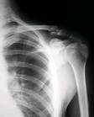




Investigative PROCEDURES
Either rule out or confirm the presence of a condition that result to the patient’s symptoms
  Laboratory and diagnostic test performed
  Review of available records
  Review of other clinical findings

Slide 52
Summary & Questions
Scales to assess pain
Pain assessment in details. 7 marks
Types of pain. 7 marks

